Slide 1

Sellinger Applied Portfolio
Portfolio Review Spring ‘19

Slide 2

Table of Contents
Overview
Economic Conditions
Sector Summaries
Portfolio Strategy & Composition
  Growth
  Value
  Dividend
Risk Analysis
Performance Review
Student Biographies

Slide 3

Overview

Slide 4
Sellinger Applied Portfolio Overview
Background
Process
The Student-Managed Sellinger Applied Portfolio Fund “SAP Fund” was established to provide students with actual portfolio management experience. Students are exposed to various aspects of the portfolio management process, including asset valuation, diversification, portfolio optimization, asset selection, risk management, performance evaluation, and rebalancing . Each year the University may provide the SAP Fund with up to $500,000 to invest. These funds are a component of the University’s endowment.
The faculty hand selects 20 eligible students to manage the Sellinger Applied Portfolio Fund each semester. Member participation stems from team formation to analyze and pitch stock recommendations for the fund to invest in. Members in their entirety then vote on whether the recommendations pass and are implemented into the fund.

Slide 5
Sellinger Applied Portfolio Overview
Objective
Select stocks that are undervalued and will outperform their industry and the S&P 500 index over the course of the investment period.
Asset Allocation Targets
Not more than 10% invested in any one stock
Not more than 20% invested in any one sector
Not more than 25% invested in any one index
40% Value | 40% Growth | 20% Dividend
No “sin” stocks
Benchmark
S&P 500 Index

Slide 6

Economic Conditions

Slide 7
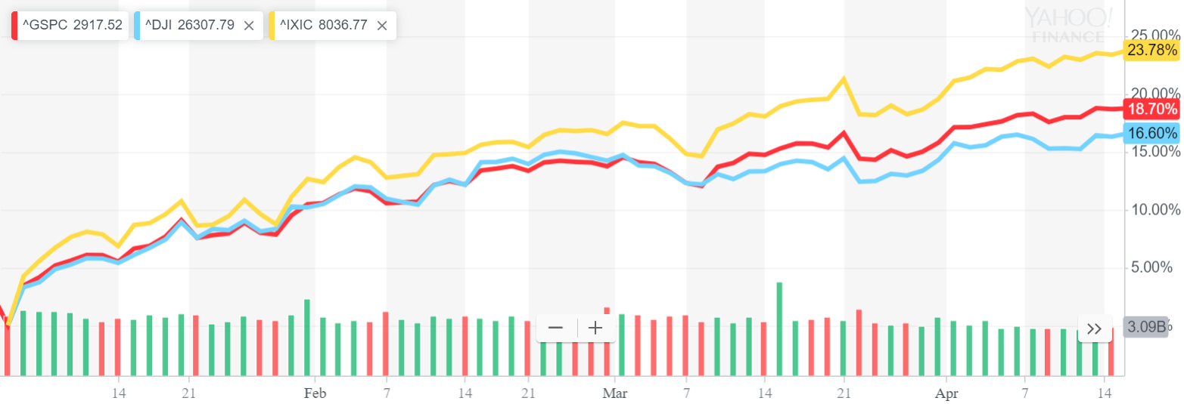
Major Indices Return
S&P
Year to Date Return
18.7%
DJI
16.6%
NASDAQ
23.78%

Slide 8
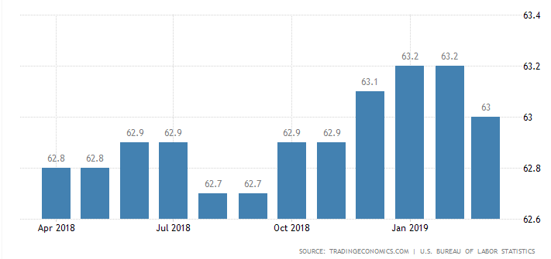
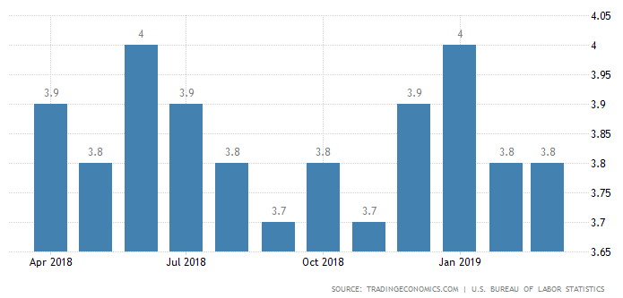
Employment
Labor force participation rate
Labor force participation- as of March 2019 participation stands at 63%
Labor force unemployment- as of March 2019 unemployment is at 3.8%
According to the Bureau of Labor Statistics, 7.4% growth in employment by 2026 with the highest growth in financial services, tech and healthcare.
Labor force unemployment rate

Slide 9
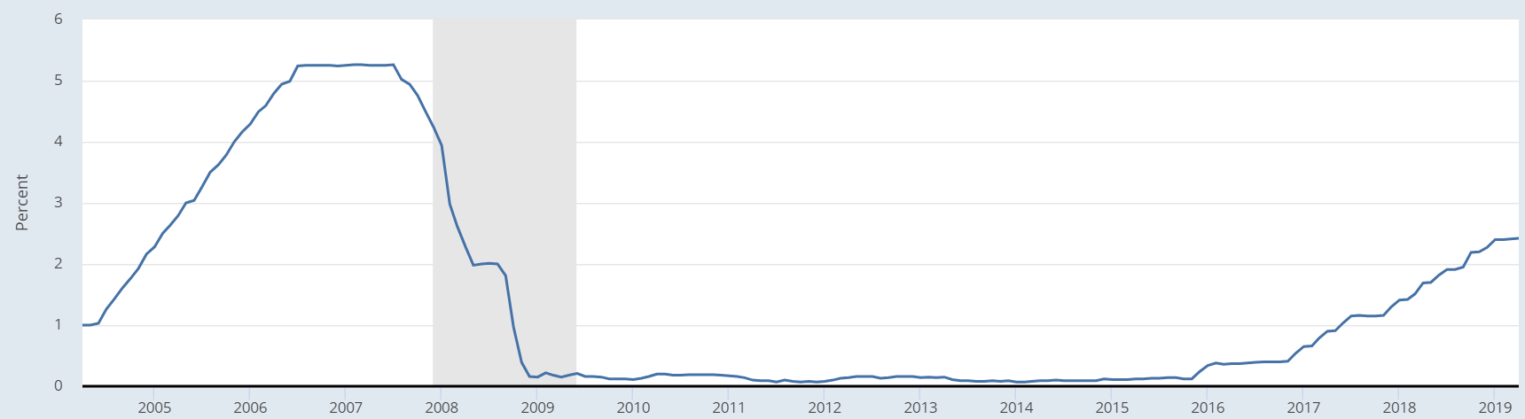
Federal Reserve Policy
Federal Funds Rate over the last 15 Years
Current Federal Funds Rate: 2.5%
The Federal Reserve signaled it would keep rates at 2.5% through 2021.
President Donald Trump has called on the Federal Reserve to decrease interest rates.
President Trump has been accused of attempting to politicize the central bank.
He has had two failed Fed nominations this year, Stephon Moore and Herman Cain.

Slide 10
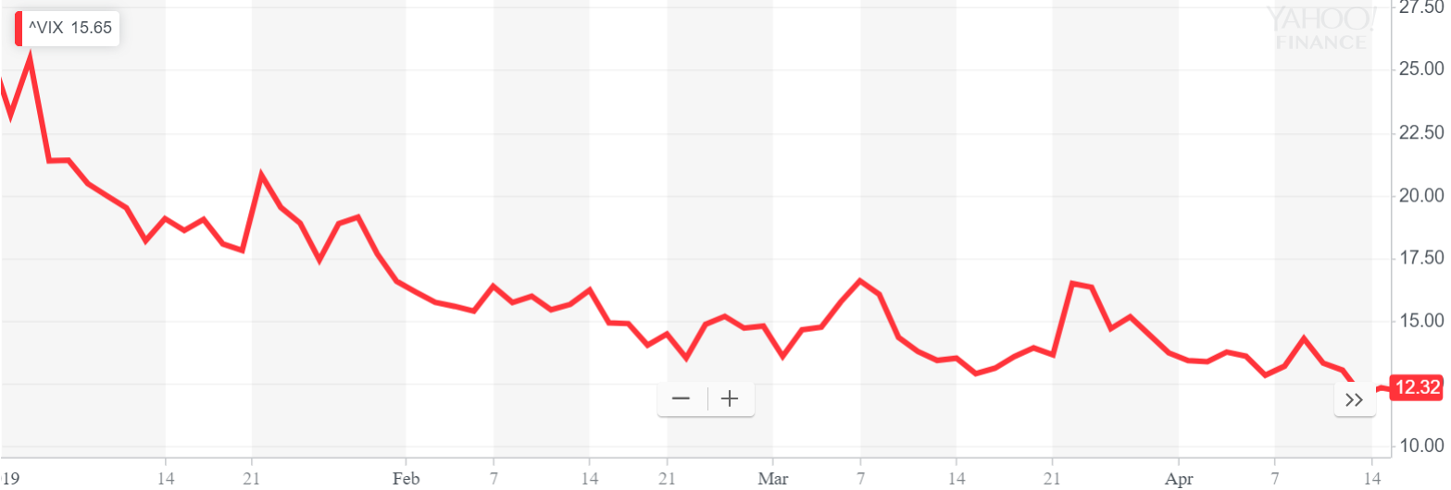
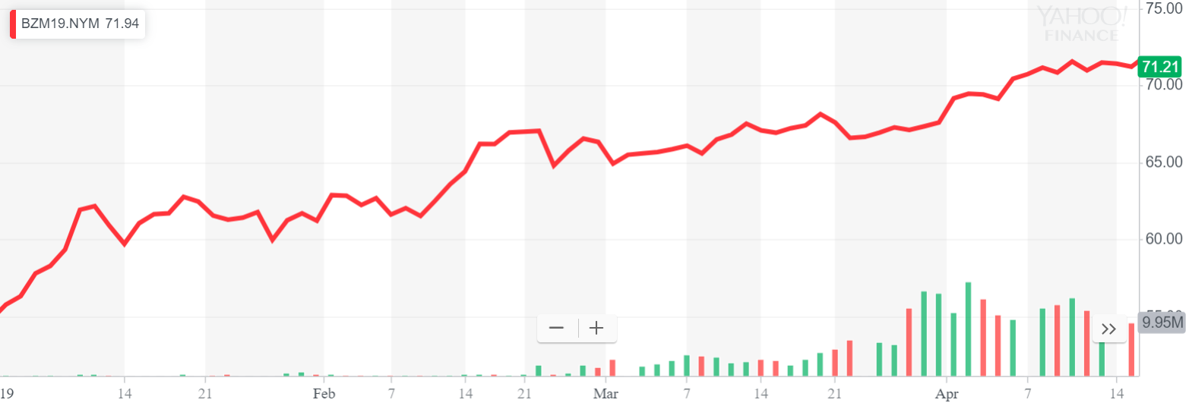
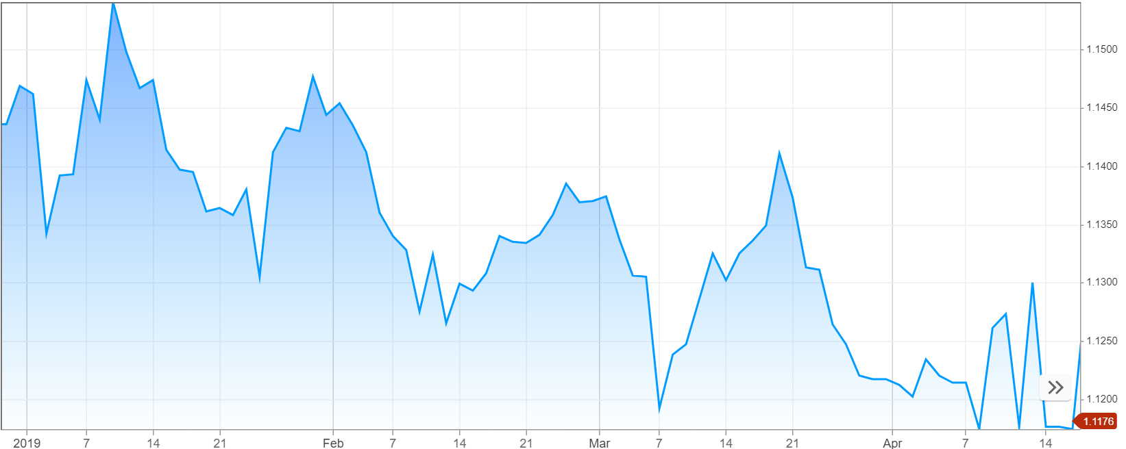
Market Overview
Vix YTD: 15.65 (on 4/15/19)
The market has been performing well since a poor Q4 of 2018.
  The VIX, a fear indicator, has been on a steady decline.
Oil prices have been increasing.
  Venezuela is a member of OPEC, their political crisis has cut global supply of oil, increasing oil prices.
The US dollar has been strengthening.
  The US’s economy has been strong compared to China and Europe.
Brent Crude Oil YTD: 71.21 (on 4/15/19)
EUR/USD YTD: 1.1307 (on 4/15/19)

Slide 11
International News
China
The US and China have been entrenched in trade talks and have been unable to agree on issues regarding intellectual property and tariffs. Increasing retaliation from both sides has adversely affected the global economy and currently, there is no sign of a compromise between the two nations. However, US investment in China has increased despite this looming threat.
Europe
Britain has been unable to finalize a deal around leaving the EU and has resulted in a 6 month extension for Brexit to occur. The deal closing process has resulted in many members of parliament resigning and risen concerns about whether Europe should withdraw. However, Britain announced it still intends to withdraw from the EU and on good terms with a deal.

Slide 12

Sector Summaries

Slide 13
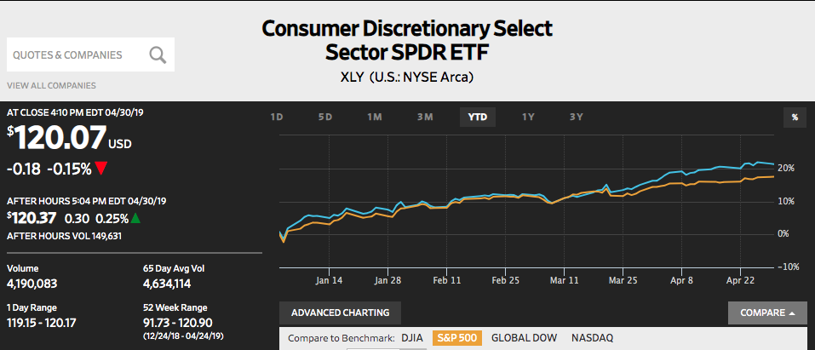
Consumer Discretionary
YTD:
21.27%
Portfolio Holdings
Nike (NKE)
Walt Disney (DIS)
Dick’s Sporting Goods (DKS)
Norwegian Cruise Line (NCLH)
Stocks to Watch
Ferrari (RACE)
Amazon (AMZN)
The Consumer Discretionary sector is determined by goods that are non essential to humans, but rather desirable if their income allows for it. Consumer Discretionary goods are heavily affected by the state of the economy, which can affect consumer confidence. If the economy is in poor condition, it is more likely that consumers will forego the purchase of these items. Examples of consumer discretionary items include things such as durable goods, apparel, entertainment, and leisure.
The Consumer Discretionary sector is expected to be a market leader in 2019, driven by sustained improvement in consumer spending that is supported by labor market health, wage increases, and outlook for earnings growth.

Slide 14
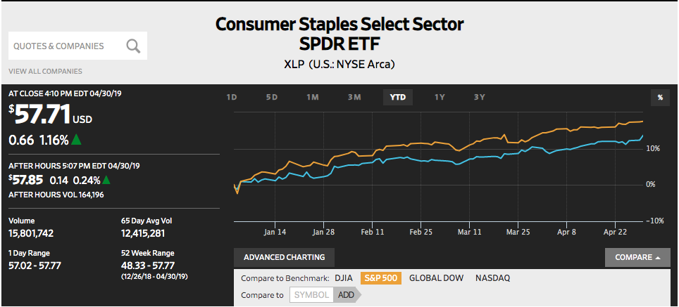
Consumer Staples
YTD:
13.65%
Portfolio Holdings
Walmart (WMT)
Pepsi Co (PEP)
Target (TGT)
Estee Lauder (EL)
Consumer Staples ETF (XLP)
Stocks to Watch
New Age Beverage (NBEV)
Church and Dwight (CHD)
The Consumer Staples sector is determined by essential products that include food, beverage, and household goods. These goods tend to be products that consumers are unable or unwilling to cut out of their budget. Consumer Staples are considered to be non cyclical. People tend to demand products at a relatively constant level. Consumer Staples are nearly 70% of the nation’s gross national product.
The Consumer Staples sector could be affected in the future both positively and negatively. If there continues to be increased geopolitical domestic anxiety, investors may seek shelter in consumer staple stocks. However, if tensions escalate for too long, costs could rise for American producers, thus causing an increase in price for consumers.

Slide 15
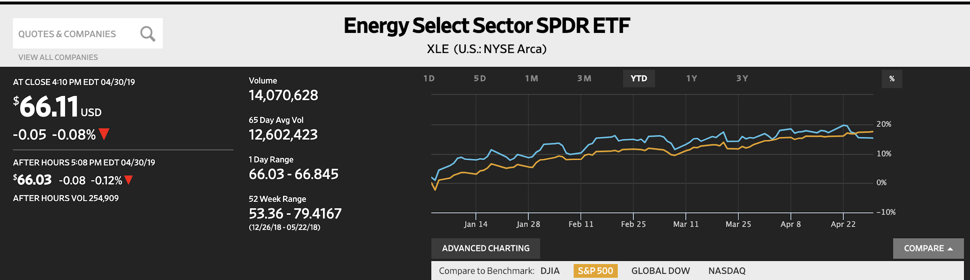
Energy
YTD:
15.27%
Portfolio Holdings
Canadian Natural Resources(CNQ)
Energy ETF (XLE)
Stocks to Watch
Exxon Mobil Corporation (XOM)
Companies within the Energy sector are involved in: exploration, drilling, production, refining, storage, and management of energy resources, such as oil, gas and coal to provide energy to their customers. This sector is driven by the supply and demand of worldwide energy and is sensitive to the business cycle. Large capital expenditures and research and development costs are often associated within this sector.
While Oil prices dropped dramatically during the 2018 campaign, the sector has rebound nicely since the beginning of 2019. Factors to keep an eye on is how OPEC regulations affect oil production and how fracking affects the price of oil.

Slide 16
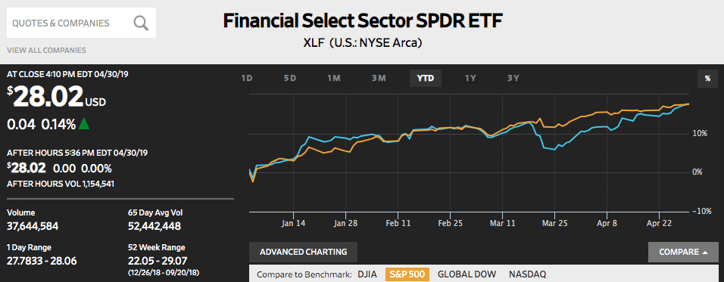
Financials
YTD:
17.63%
Portfolio Holdings
Capital One (COF)
Morgan Stanley (MS)
Keycorp (KEY)
Metlife (MET)
Stocks to Watch
JP Morgan (JPM)
The Financials sector is made up of firms and institutions that provide financial services to retail and commercial customers. A large portion of this sector generates revenue from loans and mortgages. The health of the economy is usually dependent on the financial sector; the stronger the sector, the better the health of the economy. The financial sector is one of the largest sectors.
Despite recent uncertainty, the outlook for the financials sector remains strong. Regulatory forces are encouraging innovation and new digital technologies. Big changes will be coming from banking giants, as they are forced to move away from traditional brick and mortar business practices.

Slide 17
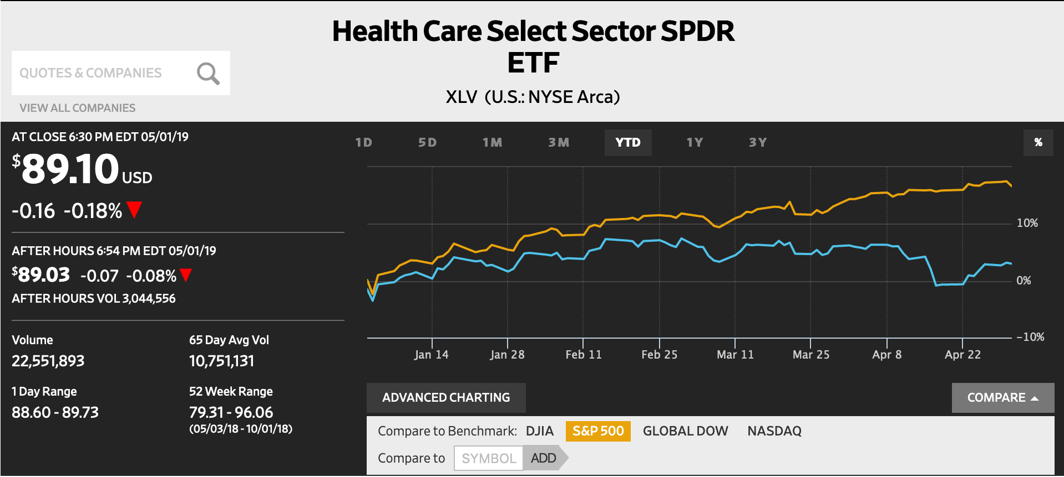
Health Care
YTD:
2.99%
Portfolio Holdings
Hospital Corporation of America (HCA)
Amgen Inc. (AMGN)
Cerner (CERN)
Health Care ETF (XLV)
Stocks to Watch
CVS Health Corp. (CVS)
Johnson & Johnson (JNJ)
The Health Care sector encompasses two main industry groups. The first includes companies who manufacture health care equipment and supplies or provide health care related services, including distributors of health care products, providers of basic health-care services, and owners and operators of health care facilities and organizations. The second regroups companies primarily involved in the research, development, production and marketing of pharmaceuticals and biotechnology products.
Aging and growing populations, greater prevalence of chronic diseases, and exponential advances in digital technologies are all developments that continue to increase health care demand and expenditures.

Slide 18
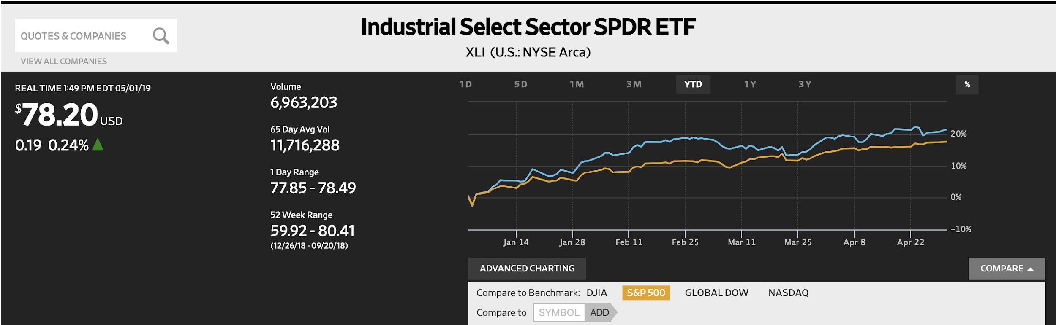
Industrials
YTD:
21.42%
Portfolio Holdings
Royal Dutch Shell- A (RDS.A)
Delta Airlines (DAL)
Caterpillar (CAT)
Eaton Corp (ETN)
Stocks to Watch
General Electric (GE)
The Industrials sector includes companies whose businesses are dominated by one of the following activities: The manufacture and distribution of capital goods, including aerospace & defense, construction, engineering & building products, electrical equipment and industrial machinery. The provision of commercial services and supplies, including printing, employment, environmental and office services. The provision of transportation services, including airlines, couriers, marine, road & rail and transportation infrastructure.
Industrials is seen sometimes as a defensive sector because of its ability to withstand a recession. This would mean limited upside in times of growth, but it had good returns this year with high amounts of government spending.

Slide 19
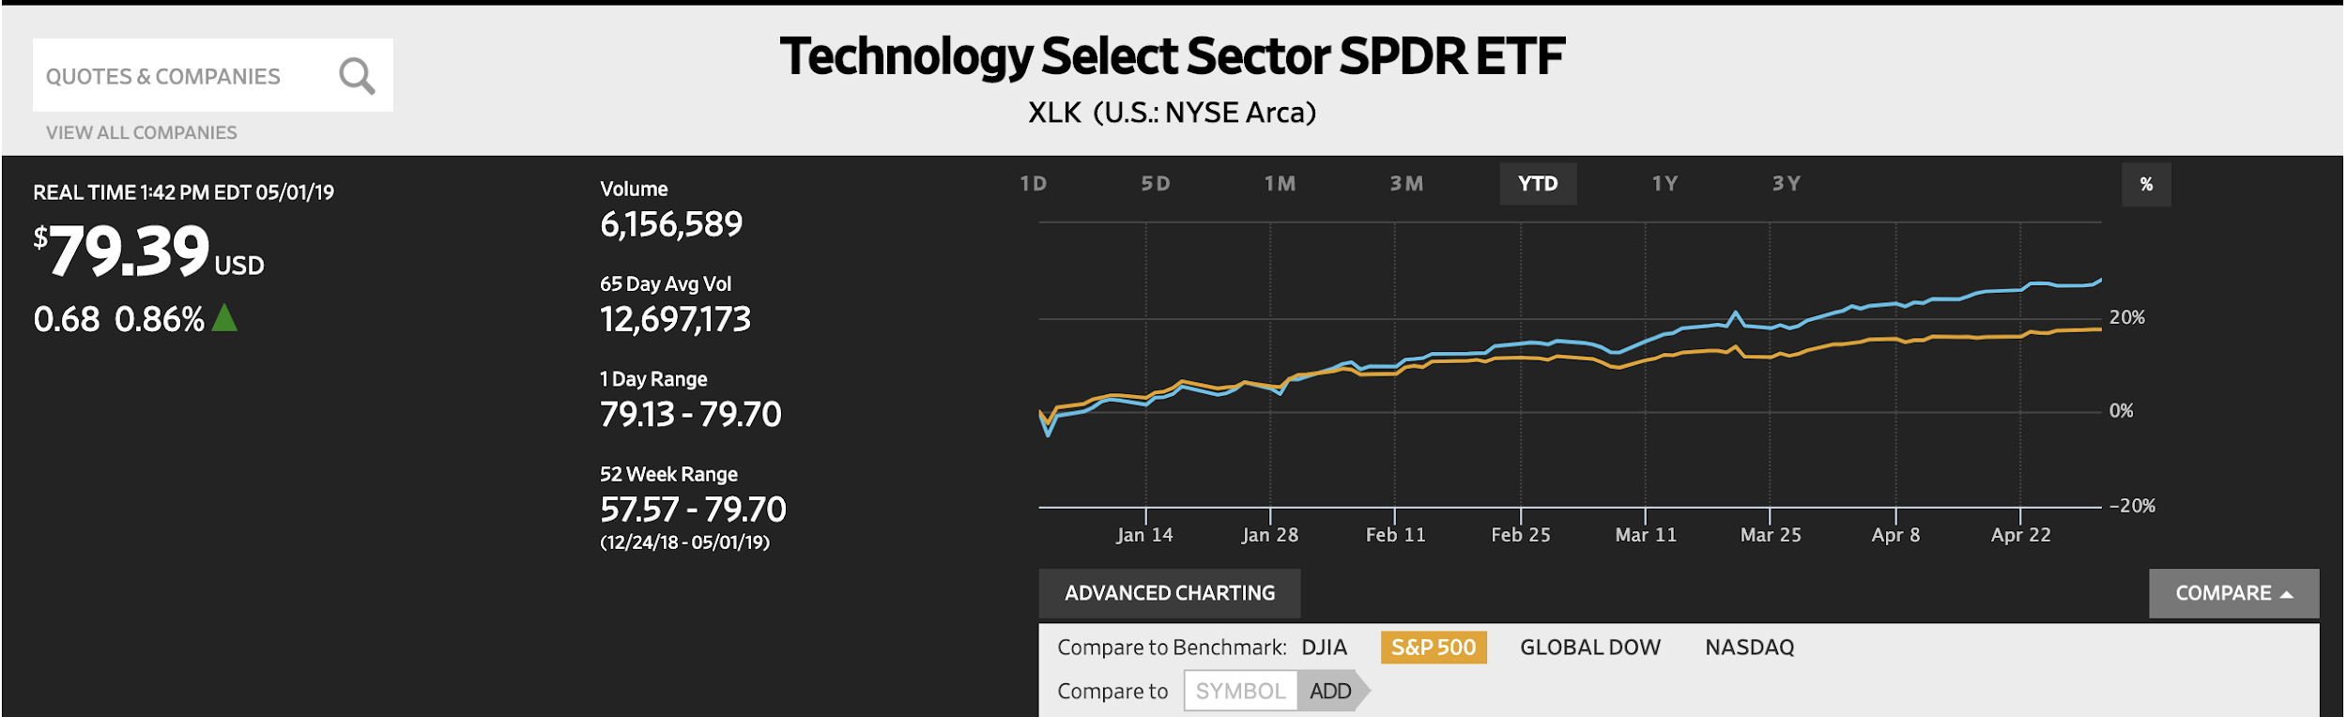
Information-Technology
YTD:
28.16%
Portfolio Holdings
Technology ETF (XLK)
Intel (INTC)
Microsoft (MSFT)
Take-Two Interactive (TTWO)
Adobe (ADBE
Stocks to Watch
Facebook (FB)
The Information Technology sector covers the following general areas: firstly, Technology Software & Services, including companies that primarily develop software in various fields such as the Internet, applications, systems, databases management and/or home entertainment, and companies that provide information technology consulting and services, as well as data processing and outsourced services; secondly Technology Hardware & Equipment, including manufacturers and distributors of communications equipment, computers & peripherals, electronic equipment and related instruments; and thirdly, Semiconductors & Semiconductor Equipment Manufacturers.
Information-Technology is susceptible to cyclical trends, but with recession fears fading there is reason for optimism that the sector will continue to see strong growth through the rest of 2019.

Slide 20
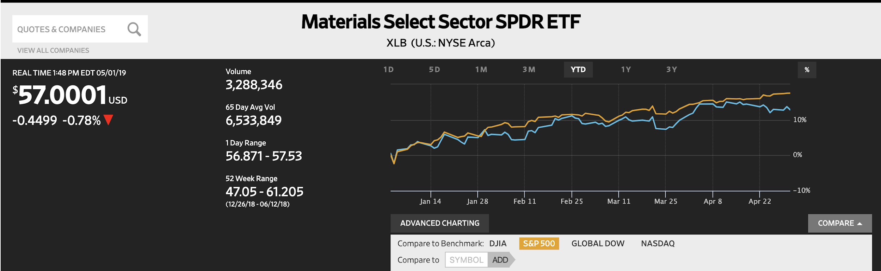
Materials
YTD:
12.89%
Portfolio Holdings
Materials ETF (XLB)
Stocks to Watch
LyondellBasell Industries (LYB)
The Materials sector contains a wide range of commodity-related manufacturing industries. Some of the specific industries that are in this sector are chemicals, construction materials, containers and packaging, metals and mining, and paper and forest products.
The Materials sector is also seen as more defensive which is the reason why its upside is limited in situations of economic growth like so far in 2019. However, this also means it doesn’t have as much downside in a recession.

Slide 21
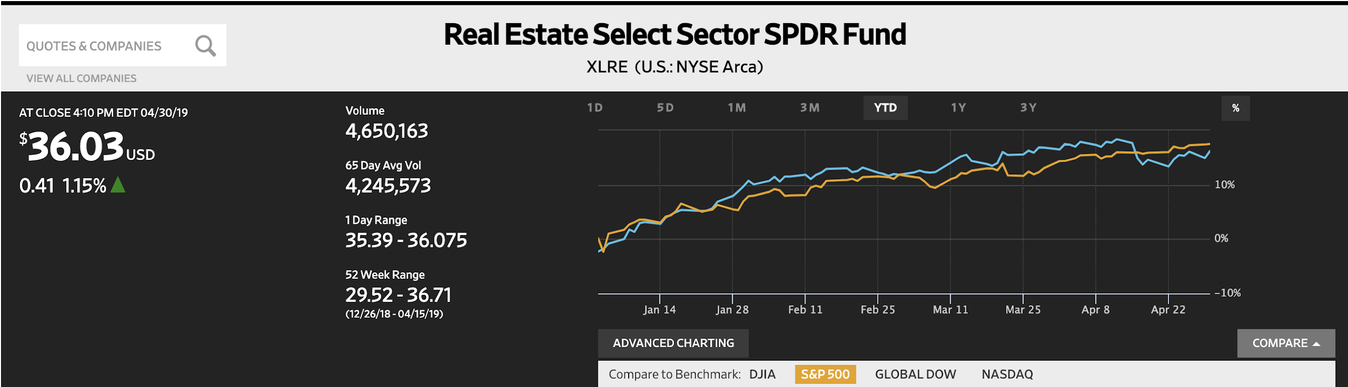
Real Estate
YTD:
16.23%
Portfolio Holdings
Well Tower (WELL)
Real Estate ETF (XLRE)
Stocks to Watch
American Tower Corporation (AMT)
The Real Estate sector covers all Real Estate Investment Trusts (REITs) besides Mortgage REITs, which can be found in the Financial sector. A REIT is an investment vehicle that invests in real estate through property mortgages and is usually very liquid. The three broad categories of Real Estate include: Residential, Commercial and Industrial.
The Real Estate sector began to rose in 2018 and continued that trend so far in 2019. The main factors that affect this sector are interest rates, government policies and the overall economy.

Slide 22
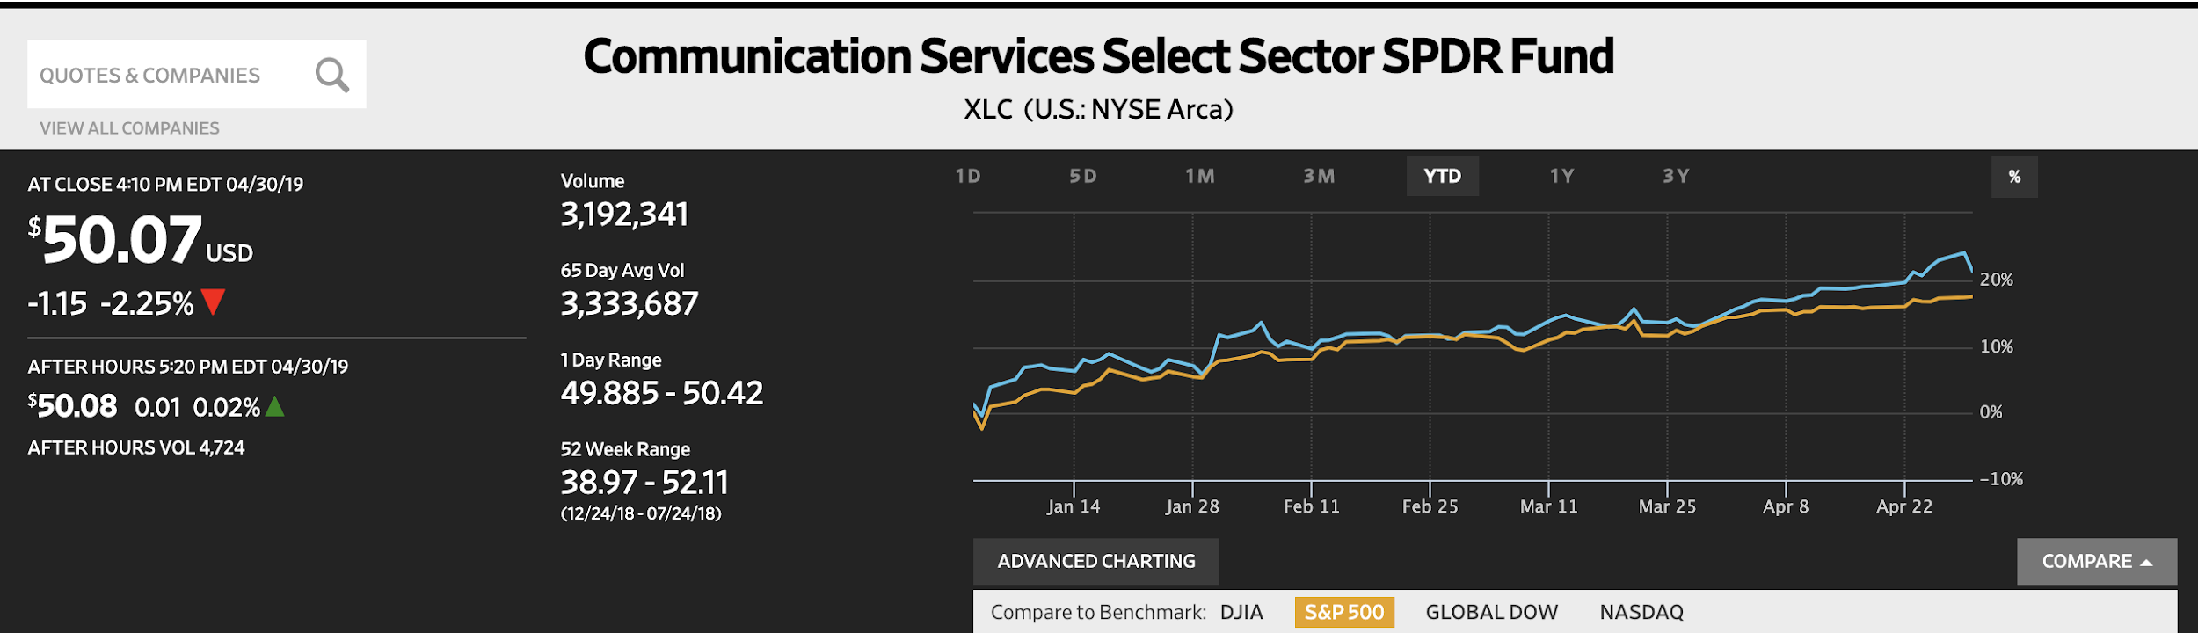
Telecommunications
YTD:
21.29%
Portfolio Holdings
AT&T (T)
Vodafone Group (VOD)
Comcast Corp. (CMCSA)
Communications Service ETF (XLC)
Stocks to Watch
Verizon Communications Inc. (VZ)
The Telecommunications sector consists of companies that provide communications services primarily through fixed-line, cellular, wireless, high bandwidth, and/or fiber-optic cable networks. In recent years the sector’s structure has changed from predominantly large players to a more diverse sector due to decreased regulation, which allows for easier entry.
The Telecommunication sector was consistent for the most part of 2018, but saw a huge spike in 2019. Factors that will continue to grow this sector in the coming year include the evolution of wireless internet and the expansion of high-speed, fiber-based networks such as 5g.

Slide 23
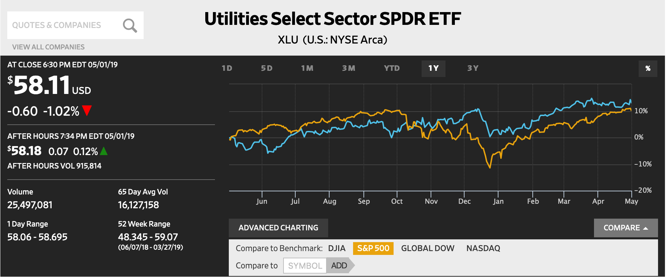
Utilities
YTD:
13.05%
Portfolio Holdings
Utilities ETF (XLU)
Stocks to Watch
NextEra Energy (NEE)
National Grid (NGG)
The Utilities sector encompasses those companies considered electric, gas or water utilities, or companies that operate as independent producers and/or distributors of power.
Utilities earn a profit but are a public service and, as a result, have substantial regulation. Investors often purchase shares of stocks in the utilities sector to serve as long-term holdings for their dividend income and stability. The utility sector tends to do well as a defensive play against macroeconomic downturns.

Slide 24

Risk Analysis

Slide 25
Portfolio Risk Analysis: Beta
SAP
Β 1.0
S&P 500
β 1.0
VS.
Canadian Natural Resources, Caterpillar, and Keycorp
Highest betas in the Fall 2019 SAP fund
Risk ≠ Reward
The higher risk stocks in our portfolio did not tend to have higher returns as shown by the negative trend-line.

Slide 26
Portfolio Risk Analysis: Weighted Beta
SAP
Β 0.99
S&P 500
β 1.0
VS.
Microsoft, Caterpillar, Nike
Highest weighted betas in the SAP portfolio
Risk = Reward
The high risk stocks in our portfolio with higher weights did usually generate the highest reward as shown by the positive trend-line.
Note: Largest points represent highest weighted

Slide 27

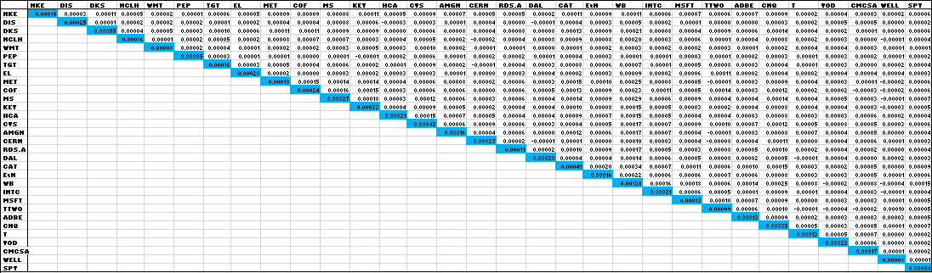
Covariance Matrix

Slide 28
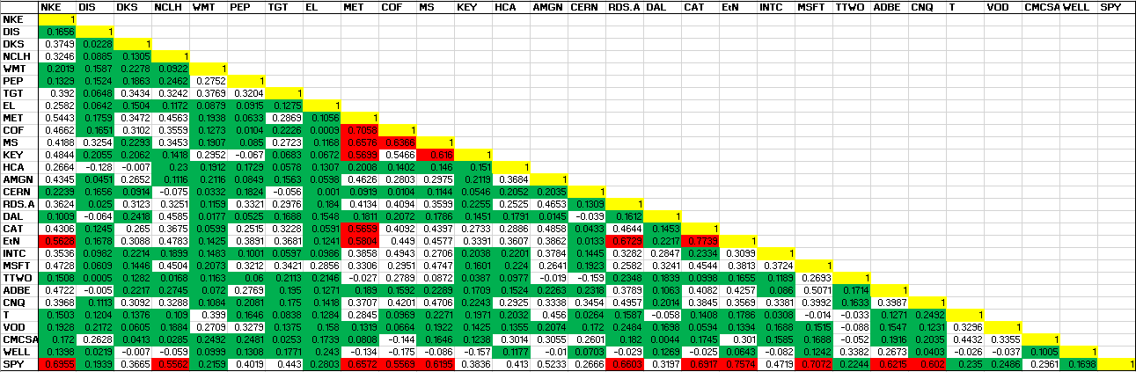
Correlation Matrix

Slide 29

Portfolio Strategy
& Composition

Slide 30
Growth Strategy Overview
To find stocks expected to grow faster than their industry peers
BUY CRITERIA
Conservative Mentality | Expect stock to perform better than the Industry
Revenue Growth | Industry Average and forecasted to continue to grow
Strong Earnings | 5 years of CAGR
ROE | ≥ 15% and > Industry Average
PEG | ≤ 1.2 and < Industry Average
Debt/Equity | < 1.5 (or Acceptable Interest Coverage Ratio when D/E >1.0)
SELL CRITERIA
Price | Price reaches 10% below target price or 20% above purchase price
Leadership | The company’s leadership position changes
Business Fundamentals | Business fundamentals deteriorate
Company slowdown | Slowing unit volume, revenue decline, weak earnings, etc.
Alternative Investments | Superior investment alternatives are identified

Slide 31
Growth Strategy Overview
Stop Loss Criteria
Acquisitions
20% Loss
Microsoft Corporation
Take-Two Interactive Software, Inc.
Adobe, Inc.
Comcast Corporation
The Estée Lauder Companies Inc.

Slide 32
Growth Strategy Position Changes
Microsoft Corporation | MSFT
Buy Criteria
Industry Average
MSFT
Position
123 Shares | $19,190.46
Position (Date Purchased: 02-19-2019)
140 Shares | $14,833.40
Revenue growth
-
5.65%
Microsoft Corporation was founded in April of 1975 and is currently headquartered in Redmond, Washington. Microsoft operates in the technology sector and its primary business is within the software - infrastructure industry. Microsoft serves a worldwide customer base and has over 134,000 employees. Microsoft offers a wide range of technological products including productivity and business processes products (Microsoft Office, LinkedIn), intelligence cloud products (Azure, SQL Server), as well as personal computing products (Windows OS, Xbox).
5 years of CAGR
-
7.2%
ROE
15.6%
39.4%
PEG
2.05
1.96
Debt/ Equity
1.0
0.8

Slide 33
Growth Strategy Position Changes
Take-Two Interactive Software, Inc. | TTWO
Buy Criteria
Industry Average
TTWO
Position
123 Shares | $19,190.46
Position (Date Purchased: 02-21-2019)
110 Shares | $9,691.66
Revenue growth
-
18.30%
Take-Two Interactive Software, Inc. was founded in September of 1993 and is currently headquartered in New York, New York. Take-Two Interactive operates in the technology sector and its primary business is within the electronic gaming & multimedia industry. Take-Two Interactive serves a worldwide customer base and has over 4,200 employees. Take-Two Interactive develops video games and is most well-known for its two publishing labels Rockstar Games and 2K Games/Sports which have developed extremely successful AAA gaming series such as Grand Theft Auto, Red Dead Redemption, and NBA 2K.
5 years of CAGR
-
8.1%
ROE
17.30%
21.46%
PEG
2.36
1.9
Debt/ Equity
12.5
18.3

Slide 34
Growth Strategy Position Changes
Adobe Inc. | ADBE
Buy Criteria
Industry Average
ADBE
Position
123 Shares | $19,190.46
Position (Date Purchased: 02-27-2019)
39 Shares | $10,229.62
Revenue growth
-
23.49%
Adobe Inc. was founded in December of 1982 and is currently headquartered in San Jose, California. Adobe operates in the technology sector and its primary business is within the software - prepackaged software industry. Adobe serves a worldwide customer base and has over 21,000 employees. Adobe offers creativity & design products, marketing analytic products, PDF & E-Signature products, cloud-based software products, and also business solutions software products.
5 years of CAGR
-
17.4%
ROE
6.9%
29.1%
PEG
1.9
1.26
Debt/ Equity
0.5
0.4

Slide 35
Growth Strategy Position Changes
Comcast Corporation | CMCSA
Buy Criteria
Industry Average
CMCSA
Position
123 Shares | $19,190.46
Position (Date Purchased: 03-20-2019)
250 Shares | $9,741.80
Revenue growth
-
8.25%
Comcast Corporation was founded in June of 1963 and is currently headquartered in Philadelphia, Pennsylvania. Comcast operates in the communication services sector and its primary business is within the pay television industry. Comcast primarily serves customers inside the United States, but has recently made some strategic moves to begin expansion into international markets. Comcast has over 184,000 employees. Comcast offers products and services such as cable television, broadcasting, internet service, movie production, and also owns its own parks & resorts through its ownership of NBC Universal.
5 years of CAGR
-
7.9%
ROE
16.73%
11%
PEG
1.1
2.17
Debt/ Equity
1.5
1.7

Slide 36
Growth Strategy Position Changes
The Estée Lauder Companies Inc | EL
Buy Criteria
Industry Average
EL
Position
123 Shares | $19,190.46
Position (Date Purchased: 04-11-2019)
60 Shares | $10,074.59
Revenue growth
2.05%
15.72%
The Estée Lauder Companies Inc was founded in 1946 and is currently headquartered in New York, NY. The Estée Lauder Companies Inc are a leading global manufacturer of skin care, makeup, hair care, and fragrance products. They market and sell products in over 150 countries. They primarily sell their products at upscale department stores, online, and spas. The Estée Lauder Companies Inc is part of the Consumer Staples sector and is in the Household and Personal Products industry.
5 years of CAGR
3.72%
6.09%
ROE
11.9%
36.8%
PEG
20
3.0
Debt/ Equity
-
0.8

Slide 37
Value Strategy Overview
To find stocks priced less than their intrinsic value
BUY CRITERIA
Price/Sales | < Industry Average
Price/Book | < Industry Average
Dividends | > Industry Average
Free Cash Flow | Positive
SELL CRITERIA
Mergers or acquisitions | Any news in regards to M&A activity
Earnings | Significant restatement
Executive Management | Changes to management
Price Targets | Exceeds initial price target
Price | Trending downwards towards a stop loss mark

Slide 38
Value Strategy Overview
Stop Loss Criteria
Acquisitions
Target Corporation
Capital One
Morgan Stanley
Delta Air Lines, Inc.
KeyCorp
Canadian Natural Resources
Norwegian Cruise Line Holdings
Vodafone Group PLC
MetLife, Inc.
Cerner Corporation
Eaton Corporation PLC
20% Loss

Slide 39
Value Strategy Position Changes
Target Corporation| TGT
Buy Criteria
Industry Average
TGT
Position (Date Purchased: 02-06-2019)
140 Shares | $9,945.60
Price/ Sales
0.6
0.5
The Target Corporation was founded in 1902 and is currently headquartered in Minneapolis, MN. The Target Corporation operates general merchandise discount stores and an e-commerce site focused on merchandising operations that encompasses general merchandise and an assortment of food products. They work to differentiate themselves from competitors by offering signature categories (style, baby, kids, and wellness) that carry higher margins and faster growth rates than other areas of its business. The Target Corporation is part of the consumer staples sector and is in the discount stores industry.
Price/ Book
4.2
3.4
Dividend Yield
1.8%
3.5%
Positive Cash Flow
Yes
Yes

Slide 40
Value Strategy Position Changes
Capital One | COF
Buy Criteria
Industry Average
COF
Position (Date Purchased: 02-14-2019)
125 Shares | $9,931.25
Price/ Sales
4.7
1.3
Capital One is a financial holding company founded in 1988. Capital One is a diversified lender in 3 segments. It is the third largest issuer of credit cards, and also operates in Consumer Banking and Commercial Banking. Its services range from credit cards, checking & savings, Auto Loans, Business, and Commercial. Ranked number 100 on the Fortune 500 Company list, Capital One is a top 10 U.S. bank with a market capitalization of 36.4 billion. Capital One is headquartered in McLean, VA and is run by CEO Richard. D. Fairbank
Price/ Book
4.6
0.7
Dividend Yield
0.9%
2.1%
Positive Cash Flow
Yes
Yes

Slide 41
Value Strategy Position Changes
Morgan Stanley | MS
Buy Criteria
Industry Average
MS
Position (Date Purchased: 02-14-2019)
245 Shares | $9,976.40
Price/ Sales
2.8
1.9
Morgan Stanley is a multinational investment bank and financial services company. It was founded by Henry Sturgis Morgan and Harold Stanley in 1935 and has since grown to employ 50,000+ employees. The company has offices in 42 countries and its clients include corporations, governments, institutions, and individuals. The three business segments that Morgan Stanley operates in are Institutional Securities, Wealth Management, and Investment Management.
Price/ Book
1.9
1.0
Dividend Yield
1.8%.
2.8%
Positive Cash Flow
Yes
Yes

Slide 42
Value Strategy Position Changes
Delta Air Lines, Inc. | DAL
Buy Criteria
Industry Average
DAL
Position (Date Purchased: 02-19-2019)
300 Shares | $15,021.00
Price/ Sales
0.9
0.8
Originally founded as a crop dusting operation in 1924, Delta has since grown into one of the world’s largest global airlines. It is headquartered in Atlanta, Georgia and employs 86,000+ people. Delta operates a fleet of over 800 aircrafts serving more than 180 million customers each year. It has been ranked No. 1 in the Business Travel News Annual Airline survey for seven consecutive years.
Price/ Book
2.5
2.47
Dividend Yield
1.1%.
2.6%
Positive Cash Flow
Yes
Yes

Slide 43
Value Strategy Position Changes
KeyCorp| KEY
Buy Criteria
Industry Average
KEY
Position (Date Purchased: 02-21-2019)
575 Shares | $10,192.11
Price/ Sales
3.8
3.0
KeyCorp was founded in 1958 and is currently headquartered in Cleveland, OH. KeyCorp is a bank-based financial services company. The Company operates through its subsidiary, KeyBank National Association (KeyBank), which is engaged in providing banking services. They have their services in 16 states. KeyCorp offers its Products and Services in more than 1,197 Retail Banking
Locations, and 1,572 ATMs. KeyCorp is part of the Financial Services sector and is in the U.S. Regional Banks industry.
Price/ Book
1.5
1.3
Dividend Yield
2.4%
3.82%
Positive Cash Flow
Yes
Yes

Slide 44
Value Strategy Position Changes
Canadian Natural Resources | CNQ
Buy Criteria
Industry Average
CNQ
Position (Date Purchased: 02-27-2019)
356 Shares | $10,190.89
Price/ Sales
2.2
2.0
Canadian Natural Resources is a Canadian oil and gas exploration, development, and production company. It was founded in 1973 and the company headquarters are in Calgary, Canada. Canadian Natural Resources is the largest independent natural gas producer and heavy crude oil producer in Canada. The company has one of the largest undeveloped land bases in the Western Canadian Sedimentary Basin.
Price/ Book
1.7
1.4
Dividend Yield
2.1%.
3.6%
Positive Cash Flow
Yes
Yes

Slide 45
Value Strategy Position Changes
Norwegian Cruise Line Holdings | NCLH
Buy Criteria
Industry Average
SJM
Position (Date Purchased: 03-13-2019)
180 Shares | $9,944.23
Price/ Sales
2.5
2.0
Norwegian Cruise Line Holdings was founded in 1966 and is currently headquartered in Miami, FL. Norwegian Cruise Line Holdings operates the Norwegian Cruise Line, Oceania Cruises, and Regent Seven Seas Cruises brands. They have a wide range of cruise destinations across the entire globe. They own and operate 25 ships with approximately 50,400 berths. Norwegian Cruise Line Holdings is part of the Consumer Cyclical sector and is in the leisure industry.
Price/ Book
2.8
2.8
Dividend Yield
1.5
0
Positive Cash Flow
Yes
Yes

Slide 46
Value Strategy Position Changes
Vodafone Group Plc | VOD
Buy Criteria
Industry Average
VOD
Position (Date Purchased: 03-13-2019)
550 Shares | $10,120
Price/ Sales
1.4
1.0
Founded in 1983, Vodafone is one of the largest telecommunications companies in the world. They offer mobile devices, mobile & fixed & TV connectivity. VOdafone is an industry leader in IoT solutions and also offers Cloud, security, carrier & connectivity services. Vodafone’s network reaches 182 countries, and was named 2019’s Global Network Services Leader by Gartner. Vodafone is headquartered in Newbury, UK and operates under CEO Nick Read.
Price/ Book
1.7
0.7
Dividend Yield
4.3%.
9.8%
Positive Cash Flow
Yes
Yes

Slide 47
Value Strategy Position Changes
MetLife, Inc. | MET
Buy Criteria
Industry Average
MET
Position (Date Purchased: 03-27-2019)
240 Shares | $10,117.10
Price/ Sales
0.8
0.6
MetLife is one of the world’s leading financial service companies. It was founded in 1868 and has since grown to employ 49,000+ people. MetLife has 90 million customers in over 60 countries around the world. The company focuses on providing insurance, annuities, employee benefits, and asset management to help its individual and institutional customers navigate their constantly changing world.
Price/ Book
1.1
0.8
Dividend Yield
2.9%.
4.0%
Positive Cash Flow
Yes
Yes

Slide 48
Value Strategy Position Changes
Cerner Corporation | CERN
Buy Criteria
Industry Average
CERN
Position (Date Purchased: 04-05-2019)
175 Shares | $9,980.25
Price/ Sales
4.7
3.6
Cerner Corporation was founded in 1979 and is currently headquartered in Kansas City, MO. Cerner is a top-tier healthcare information technology supplier that helps its clients improve efficiency within their complex healthcare systems. They provide 27,500 facilities including software, hardware, and services in 35 countries. Cerner’s services are used in over 30% of hospitals in the United States. Cerner Corporation is part of the Technology sector and is in the Health Information Services industry.
Price/ Book
5.8
3.8
Dividend Yield
0%
0%
Positive Cash Flow
Yes
Yes

Slide 49
Value Strategy Position Changes
Eaton Corporation PLC | ETN
Buy Criteria
Industry Average
ETN
Position (Date Purchased: 04-11-2019)
120 Shares | $9,946.49
Price/ Sales
1.8
1.7
Eaton Corporation PLC is diversified power management company that has been in operation since 1911. The company provides service in sectors such as electrical products, electrical systems and services, hydraulics, aerospace, vehicle, and eMobility. Eaton employs over 99,000 people and serves more than 175 countries around the world.
Price/ Book
4.2
2.2
Dividend Yield
2.0%.
3.2%
Positive Cash Flow
Yes
Yes

Slide 50
Dividend Strategy Overview
To find stocks fairly priced and offering a Dividend yield greater than the S&P 500
BUY CRITERIA
Dividend Yield | ≥ SPDR S&P Dividend ETF
Quick Ratio | ≥ Industry Average
Cash Dividends | Positive total cash Dividends paid annually
Positive Total Cash | From investing and operating activities
Constant Dividend | Yes
Dividend Growth | Historical and potential Dividend growth
SELL CRITERIA
Dividends | Dividends are cut
Free Cash Flow | Diminishes or is no longer positive
Alternative Investments | Superior investment alternatives are identified

Slide 51
Dividend Strategy Overview
Stop Loss Criteria
Acquisitions
20% Loss
AMGen Inc.
Welltower
Caterpillar Inc.

Slide 52
Dividend Strategy Position Changes
AMGen Inc. | AMG
Buy Criteria
Industry Average
PG
Position (Date Purchased: 02-06-2019)
80 Shares | $14,929.60
Dividend Yield
1.0%
2.7%
Founded in 1980, AMGen Inc (Applied Molecular Genetics Incorporated) focuses on diseases with limited treatment options, cardiovascular disease, oncology, bone health, neuroscience, neurology, and inflammation. They are a leader in biotechnology-based human therapeutics. They are well known for the creation of EPOGEN, one of the most successful drugs in biotech. AMGen has a presence in approximately 100 countries
Quick Ratio
1.31
2.68
Constant Dividend
-
Yes
Positive Total Cash
-
Yes

Slide 53
Dividend Strategy Position Changes
Welltower| WELL
Buy Criteria
Industry Average
WELL
Position (Date Purchased: 03-27-2019)
130 Shares | $10,190.32
Dividend Yield
2.46%
4.47%
Welltower is an equity real estate investment trust (REIT) founded in 1970 as the first healthcare focused REIT. Welltower falls under the healthcare facilities industry within the real estate sector. Welltower participates in aspects of healthcare such as hospitals, outpatient clinics, assisted living, and skilled nursing facilities. Welltower owns 1,517 healthcare properties across the U.S., Canada, and the U.K.
Quick Ratio
0.8
1.23
Constant Dividend
-
Yes
Positive Total Cash
-
Yes

Slide 54
Dividend Strategy Position Changes
Caterpillar Inc. | CAT
Buy Criteria
Industry Average
CAT
Position
123 Shares | $19,190.46
Position (Date Purchased: 04-11-2019)
75 Shares | $10,417.49
Dividend Yield
2.43%
2.46%
Caterpillar Inc. was founded in April of 1925 and is currently headquartered in Deerfield, Illinois. Caterpillar operates in the industrials sector and its primary business is within the farm & construction equipment industry. Caterpillar serves a worldwide customer base and has over 98,000 employees. Caterpillar offers products including new farming and construction equipment (machines, attachments, power systems, and parts), rental and used equipment through its dealer network, financing & insurance for its products, home & outdoor machines/generators, as well as company merchandise (t-shirts, hats, etc.).
Quick Ratio
0.8
0.96
Constant Dividend
-
Yes
Positive Total Cash
-
Yes

Slide 55
Unique Attributes
Adobe Inc. (ADBE)
Adobe’sCreative Cloud is the gold standard for content creators globally. This has created a monopolistic type of affect for Adobe and provides them protection from switching costs. Along with this, Adobe’s Experience Cloud has also been regarded as the cloud platform with the best end-to-end functionality.
Microsoft Corporation (MSFT)
Microsoft completely dominates the productivity and business processes industry with their Microsoft Office and Microsoft 365 product lines. Along with this, Microsoft is well positioned to take on the future of cloud computing with its ownership of Azure, the second largest public cloud vendor.
Comcast Corporation (CMCSA)
Comcast’s dense fixed-line networks provide platforms to easily meet consumers’ growing demand for bandwidth while also expanding their market share into new areas. Comcast is also known for having consistent recurring revenue, strong cash flows, and attracting top media related talent.
Take-Two Interactive Software, Inc. (TTWO)
Take-Two Interactive is known for its incredibly immersive and detailed video games including the super popular Grand Theft Auto franchise. Grand Theft Auto V was released in 2013, but was listed as one of the top-selling games of 2018, indicating their games’ lucrative long-term earning potential.
Caterpillar Inc. (CAT)
Caterpillar has an incredibly strong dealer network, excellent safety features, and a robust service infrastructure with sufficient parts available to ensure machine uptime. Caterpillar is also investing heavily in its research and development teams to give themselves an edge against competition.

Slide 56
Unique Attributes
Norwegian Cruise Line Holdings (NCLH)
As the baby boomers enter retirement, they are likely to travel more. Norwegian’s freestyle cruising will play into cross-generational travel trends, allowing families across demographics to travel together
Target Corporation (TGT)
They work to differentiate themselves from competitors by offering signature categories (style,baby, kids, and wellness) that carry higher margins and faster growth rates than other areas of its business.
KeyCorp (KEY)
Key’s investment banking and capital market offerings allow the bank to win business from corporate clients that seek more robust offerings but are too small to attract attention from bulge-bracket firms
Cerner Corporation (CERN)
The long term demand for Cerner’s products are robust given ACA mandates that require providers to upgrade their health records management systems
The Estée Lauder Companies Inc (EL)
Around 30% of sales in the first half of fiscal 2019 were from new products or line extensions (versus 20%-25% historically), which we think points to the firm's commitment to innovating its portfolio to stay relevant with consumer trends.

Slide 57
Unique Attributes
Delta Air Lines, along with its subsidiaries and regional affiliates, operates around 5,400 flights every day and serves an extensive network that includes over 304 destinations across 52 countries.
Delta Air Lines , Inc. (DAL)
Eaton Corporation PLC (ETN)
Along with offering over 37 different types of service within the 6 sectors in which they operate, Eaton is a two time winner of the World’s Most Ethical Companies Award.
Morgan Stanley (MS)
Morgan Stanley was recognized as the world’s top stock underwriter for the past two years. The company is in position to hold the title for the third straight year as they are the lead underwriters of the highly anticipated Uber IPO.
Canadian Natural Resources (CNQ)
Although Canadian Natural Resources main operations are in Western Canadian Sedimentary Basin, the company also has North Sea and West African fields.
MetLife, Inc. (MET)
The MetLife blimp provides aerial coverage to over 80 major sporting events every year and is currently the official aerial coverage provider of the PGA Tour. In 2011, MetLife also agreed to a 25-year sponsorship deal to rename New Meadowlands Stadium after the company.

Slide 58
Unique Attributes
AMGen inc (AMG)
AMGen acquired Onyx to bolster its therapeutic oncology portfolio and has recently launched Repatha (to lower cholesterol) and Aimovig (for migraines). Healthcare demand is inelastic, and AMGen is less risky than some competitors with its 40 years of strong performance
Vodafone Group Plc (VOD)
Vodafone made the first ever mobile call in the UK and is one of the largest carriers by number of major countries it serves. It recently acquired cable TV operations and is working to offer broadband service as well. Vodafone added 43,000 new mobile sites and installed 115,000 modernized RAN base stations
Welltower (WELL)
Welltower is America’s largest healthcare REIT. Welltower owns 1,517 healthcare properties across the U.S., Canada, and the U.K.
Capital One (COF)
Capital One is #100 on the Fortune 500 and the 3rd largest credit card issuer amd were named 2018’s “Best Travel Card” by CNBC.

Slide 59

Performance Review

Slide 60
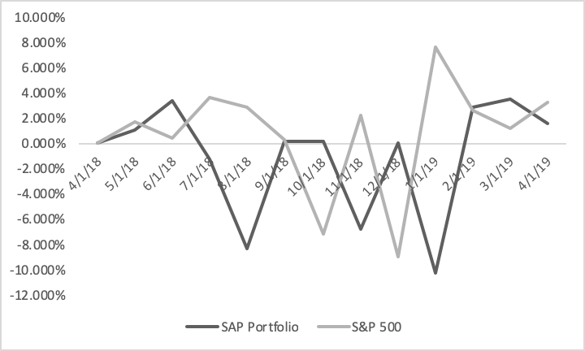
Portfolio Performance: Spring Semester ‘19
During our semester, the portfolio grew 8.08%, greater than the S&P 500’s growth of 7.18%
SAP
8.08%
S&P 500
7.18%
Performance as of : (4/1/18) - (4/1/19)
Performance Difference
The darker graph depicts the performance difference relative to the S&P 500 (percentage change month to month). Our class began investing in the in January and are responsible for growing our portfolio by nearly $45,000 over the semester.
*The red line shows where our class took control of the portfolio

Slide 61
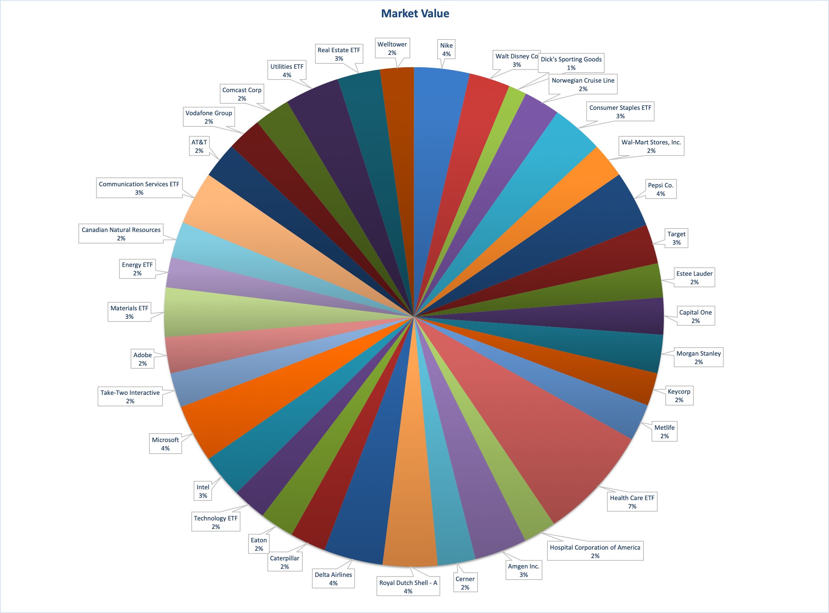
Portfolio
Allocation

Slide 62
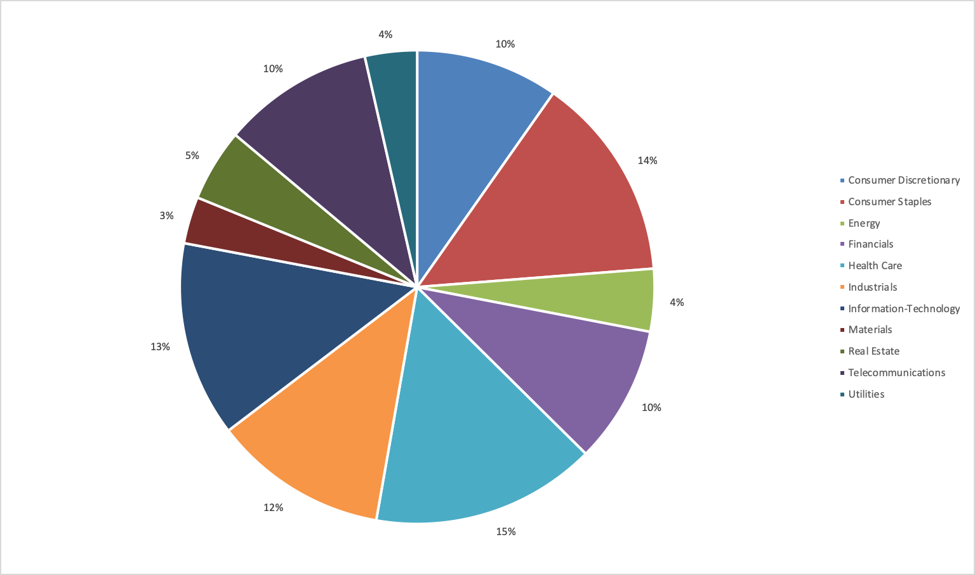
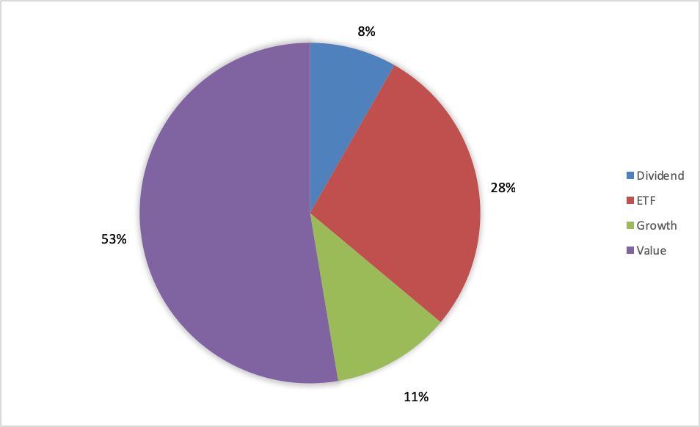
Portfolio Allocation
Portfolio Weights

Slide 63
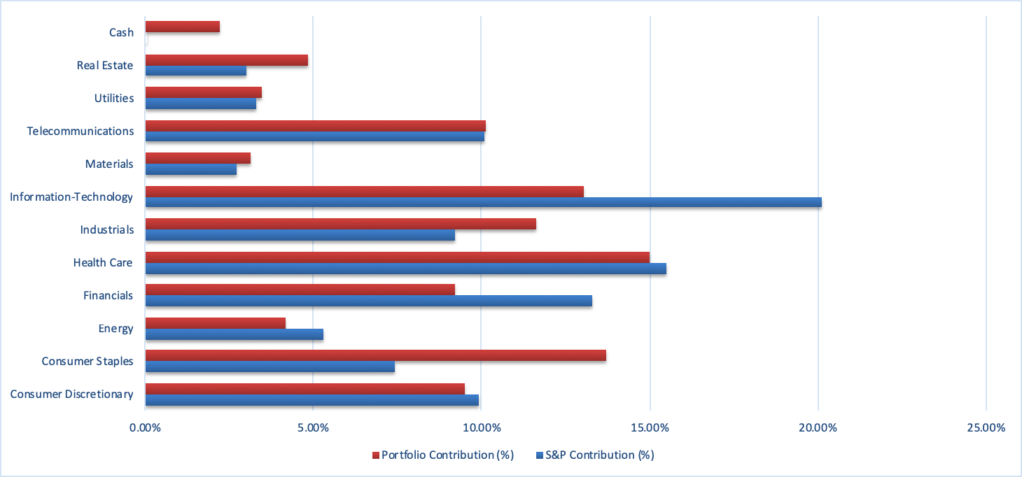
Sector Allocation
SAP vs. S&P 500

Slide 64
Performance Attribution
TOP OUTPERFORMERS
TOP UNDERPERFORMERS
INTC | Intel
HCA | Hospital Corporation of America
DIS | Walt Disney Co
KEY | Keycorp
TGT | Target
WELL | Welltower
DAL | Delta Airlines
WMT | Wal-Mart Stores, Inc.
MSFT | Microsoft
EL | Estee Lauder

Slide 65





Top Outperformers
Intel
Return: 24.21%
Sellinger Applied Portfolio Fund
Walt Disney Co.
Return: 18.81%
Sellinger Applied Portfolio Fund
Target
Return: 16.37%
Sellinger Applied Portfolio Fund
Delta Airlines
Return: 15.54%
Sellinger Applied Portfolio Fund
Microsoft
Return: 14.32%
Sellinger Applied Portfolio Fund

Slide 66
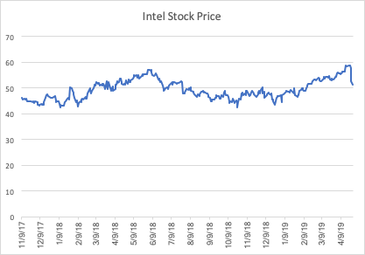
Top Outperformers
Intel | INTC
Position
226 Shares │$12,756.99
Shares of Intel were bought in November of 2017, and over that year and a half period the investment has returned over 24%.
Intel has been a major technology stock since its IPO in 1973, and has a reputation of being one of the more reliable, conservative technology investments. The company operates in the semiconductor industry, in which it is the world’s second largest manufacturer of semiconductor chips.
The stock is a value stock and has been growing strong since January of this year, but just recently the company released its earnings report which featured a lowered 2019 earnings forecast. This resulted in a minor selloff of the stock, which accounts for the dip in the stock price towards the end of the chart (left). Still, it is one of the biggest winners in our portfolio.

Slide 67
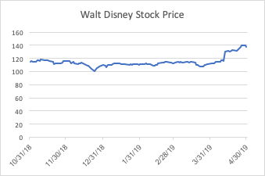
Top Outperformers
Walt Disney | DIS
Position
91 Shares │$ 11,976.95
Shares of Walt Disney stock were bought in October of last year by the previous semester’s class. Since then, this value stock has given us over an 18% return on our investment.
Recently, the stock has rallied due to Disney’s success at the box office, specifically with their Marvel movies (the company acquired Marvel Entertainment in 2009). Most recently, Captain Marvel and Avengers: End Game have been released, and both movies shattered box office records. This is good news for Disney, as this will translate into added revenue for the company.
When it comes to the theme park business side of Disney, Walt Disney World Resort will be turning 50 in 2021, and the company will be celebrating this anniversary by adding multiple new projects that are expected to drive growth. This is promising for a company that relies on consumer discretionary income for revenues.
‘Ticker’ Price

Slide 68
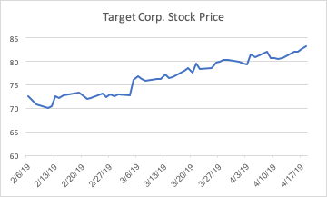
Top Outperformers
Target | TGT
Position
141 Shares │$ 11,574.10
This semester’s SAP class decided to purchase shares of Target Corp. stock in the beginning of February. In just three months’ time, the stock has grown by over 16%.
Part of the reason the stock has been rallying is because of a strong fourth quarter earnings report in March, the firm’s newly introduced one-day shipping model on its website, and on top of this, the company has been experiencing retail traffic gains. It is also worth noting that Barclay’s has also recently upgrade the company’s credit rating. All of the above is reason for the company’s incredible stock performance since the start of 2019.
Target Corp. is a dividend stock on the account of its consistent and high dividend, of which the company boasts over a 3% yield. The company is considered to operate in the consumer staples industry.
‘Ticker’ Price

Slide 69
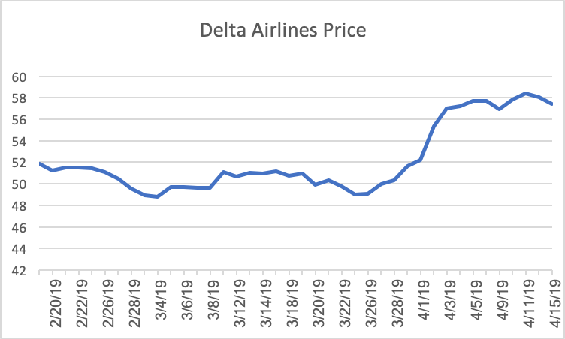
Top Outperformers
Delta Airlines | DAL
Delta Airlines stock was bought on February 19, 2019. Over the course of the semester, Delta’s stock price has increased 15.54%.
Delta Airlines is a major American airline company, headquartered in Atlanta, Georgia. Delta operates in the Industrials Sector. Delta’s stock experienced some volatility from the end of February through March 2019 due to the Boeing 739 Maa airline crashes and other technical issues which impacted the whole airline industry.
Delta is a value stock. The stock price has seen major growth throughout April 2019. The catalysts for this growth include the announcement on April 2, 2019 that the company signed an 11-year renewal extending the firm’s exclusive Delta SkyMiles Credit Cards from American Express. Delta also reported first-quarter earnings on April 10, 2019 which beat analyst expectations. Deltas revenue climbed greater than the expected 4% to $10.472 billion and unit revenue climbed 2.4%. Delta has a 90 out of 99 Composite rating which makes the Delta Airlines stock the highest-rated out of all major U.S. airlines.
Position
300 Shares │$ 15,021

Slide 70
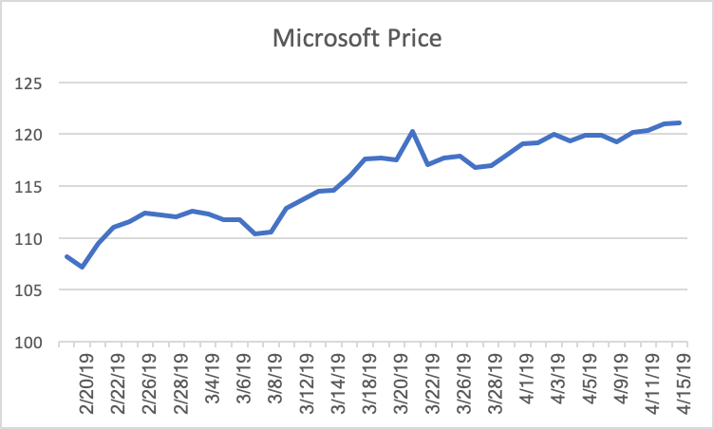
Top Outperformers
Microsoft Corporation | MSFT
Position
140 Shares │$ 14,883.40
Microsoft stock was bought on February 19, 2019. Over the course of the semester, the stock saw a return of 14.32%.
Microsoft is a technology company with a large focus on software and cloud computing. Microsoft’s stock price has gradually increased over the past two months. This is largely due to solid growth in its software businesses and increasing gains in cloud computing with Microsoft Azure.
Microsoft is a growth stock. The firm’s third-quarter results beat performance expectations. Microsoft announced $30.6 billion in revenue, up 14% compared with over a year ago, and $8.8 billion in profits which is up 19%. Microsoft’s cloud business drove these results with Microsoft Azure sales up 73% compared with last quarter. Microsoft sees future growth in its cloud computing business as it is an integral part of its growth strategy as the firm continues to invest in the cloud and IoT.

Slide 71
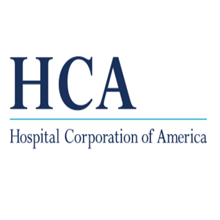




Top Underperformers
HCA
Return: -10.92%
Sellinger Applied Portfolio Fund
Keycorp
Return: -5.09%
Sellinger Applied Portfolio Fund
Welltower
Return: -2.47%
Sellinger Applied Portfolio Fund
Wal-Mart
Return: -1.75%
Sellinger Applied Portfolio Fund
Estee Lauder
Return: -0.48%
Sellinger Applied Portfolio Fund

Slide 72
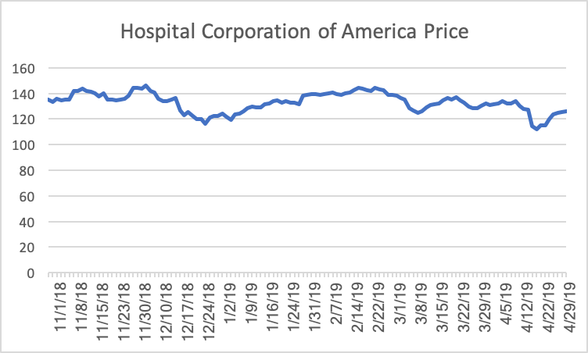
Top Underperformers
HCA | Hospital Corporation of America
Hospital Corporation of America was bought on October 30, 2018. This stock has seen a loss of 10.92%. This stock was bought last semester. Since that time, the stock has experienced some volatility with an overall decline over the past six months.
HCA is a healthcare provider organization that operates the largest collection of acute-care hospitals in the U.S. HCA is a value stock. HCA experienced additional expenses and $31 million in revenue losses associated with Hurricane Michael’s impact on the firm’s Florida facilities during the fourth quarter 2018.
The Healthcare Sector has been the worst-performing sector in the S&P 500 this year, 2019. Shares have come under pressure amid the threat of tighter health-care regulations. The presidential primary politics proposal of “Medicare for All” hurt healthcare stocks, including HCA. HCA is also expected to report a year-over-year decline in earnings on higher revenues for the quarter ended March 2019. If these earnings are better than expectations, it may help move the the stock price higher.
Position
75 Shares │$ 10,764 amount
Notes:
https://www.morningstar.com/news/dow-jones/health/TDJNDN_201904166414/hca-healthcare-down-over-7-on-pace-for-largest-oneday-decline-in-over-two-years-data-talk.html

Slide 73
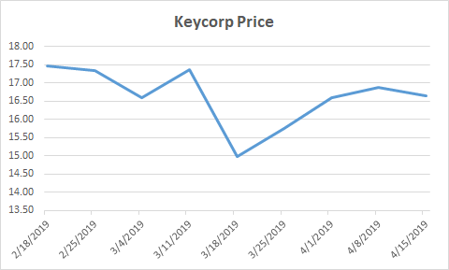
Top Underperformers
Keycorp | KEY
Keycorp was bought on February 21, 2018. This stock has seen a loss of 5.09%.
Keycorp operates as the holding company for KeyBank National Association that provides various retail and commercial banking services in the United States.
Keycorp is a value stock. They missed their earnings forecast for Q1 2019 reporting EPS of $0.40. Keycorp’s reported adjusted earnings increased since Q4 2019, but the stock experienced a decline since they failed to meet earnings forecasts. Keycorp also experienced a 2.1% decline in total revenues year over year.
The Financial Sector experienced a rebound in 2019 compared to the overall sector’s performance in 2018. The sector has reacted to positive news coming from the Fed stemming from a dovish outlook in terms of interest rate hikes. However, the financial sector is dependent on the strength of the economy. Keycorp’s stock depreciation came after their Q1 earnings and revenue miss, but historical data shows that they have beaten consensus forecasts in three of the last 4 quarters.
Position
575 Shares │$ 10,192.11 amount

Slide 74
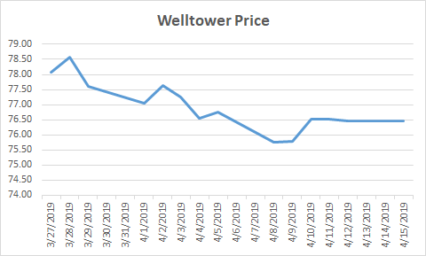
Top Underperformers
Welltower | WELL
Welltower was bought on March 27, 2019. This stock has seen a loss of 2.47%.
Welltower is a real estate investment trust “REIT” that owns interests in properties concentrated in major, high-growth markets in the United States, Canada, and the United Kingdom. Their holdings consist of seniors housing and post-acute communities and outpatient medical properties.
Welltower is a growth stock. Their stock price has experienced a marginal decline since we bought it at the end of March. Welltower reported a strong rebound from Q1 2019 regarding same store NOI growth as well their overall NOI growth rate of 2.3%. While numerous reported metrics beat expectations, Welltower executed more of their planned dispositions for 2019 than expected. They also issued more shares during the quarter than analysts expected. While Welltower’s fundamentals are strong, new share issuances as well as dispositions weighed on their stock price.
Position
130 Shares │$ 10,190.32 amount

Slide 75
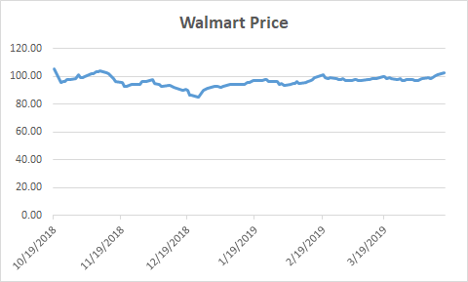
Top Underperformers
Walmart | WMT
Walmart was bought on October 19, 2018. This stock has seen a loss of 1.75%.
Walmart engages in the retail and wholesale operations in various formats worldwide. They company operates through three segments: Walmart U.S., Walmart International, and Sam’s Club. They offer grocery products, consumables, automotive products, as well as home furnishings.
Walmart is a value stock. Since we bought the stock, it has traded slightly below the initial acquisition price resulting in a 1.75% loss since it has been in our portfolio. Walmart has suffered due to increased competition arising from e-commerce. Walmart’s profitability is directly correlated to consumer spending nationwide. Walmart’s earnings growth has slowed dramatically from 19% in Q2 2018 to just 6% in the ‘holiday’ Q4 2018. Walmart’s stock price has been trending in a positive direction following fiscal year 2020 guidance for same store sales growth. Regarding their battle with Amazon for dominance, they recently outbid the e-commerce giant to acquire Flipkart. This acquisition will allow Walmart to increase their market share in India and China.
Position
100 Shares │$ 10,541 amount

Slide 76
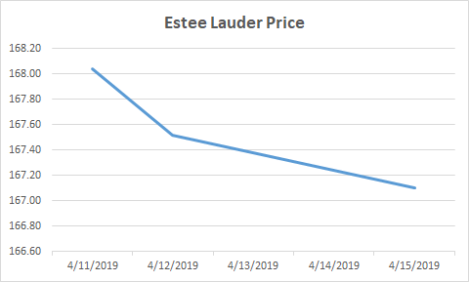
Top Underperformers
Estee Lauder | EL
Estee Lauder was bought on April 11, 2019. This stock has seen a loss of 0.48%.
Estee Lauder manufactures and markets skin care, makeup, fragrance, and hair products. The company sells its products through department stores, multi-brand retailers, pharmacies, and e-commerce stores. They have operations in the United States, Europe, the Middle East, Africa, and Asia.
Estee Lauder is a value stock. Our class recently added this security to our portfolio, so there has not been a lot of price movement since April 11. Estee Lauder recently reported Q3 earnings, and they reported both top and bottom line improvement YOY. The company also raised its sales and earnings view for fiscal year 2019. Earnings growth is likely attributed to solid investment in the second half of fiscal year 2019 in product innovation plans. Company management is now forecasting adjusted earnings for fiscal year 2019 to be $5.15-$5.19 per share, up from their original projection of $4.92-$5.00. Our class believes this stock will show solid growth based on company guidance as well as historical results. They have beaten earnings and sales forecasts for 19 straight quarters.
Position
60 Shares │$ 10,074.59 amount

Slide 77

Student Portfolios

Slide 78

Paulina Amiot
Paulina is an undergraduate student pursuing a Bachelors of Business Administration with a double concentration in Finance and Information Systems at Loyola University Maryland. Paulina is a member of the Beta Gamma Sigma Business Honor Society, Financial Management Association, Alpha Iota Delta National Decision Sciences Honorary and Love Your Melon. Previously, Paulina held an internship with GlobeTax Financial Services as an operations intern in New York City. Upon graduation, Paulina hopes to further her technology career in New York City.

Slide 79

Alexis Anduiza
Alexis is an undergraduate student pursuing a Bachelor's of Business Administration with a concentration in Finance at Loyola University Maryland. As a junior Alexis spent a semester in Lyon, France studying business at The Centre d’Etudes Franco-Americain de Management, where in addition to classes, she got to travel across Europe. She is also a member of the Financial Management Association National Honor Society and Alpha Kappa Psi. Alexis previously interned at Morgan Stanley in NYC in their Institutional Equity Division and will return as a full-time analyst in the Fall of 2019.

Slide 80

Bobby
Austin
Bobby is pursuing a Bachelors of Business Administration with a major in Finance and a minor in Information Systems at Loyola University of Maryland. He is a member of the Men’s Lacrosse Team at Loyola as well as the Chi Alpha Sigma Honor Society. Bobby worked as an investment banking analyst at Canaccord Genuity in Boston last summer on the sustainable energy and technology coverage teams. Upon graduation, Bobby will be working for H.C. Wainwright & Co. as an investment banking analyst on their life sciences team in New York City.

Slide 81

Chase Bradshaw
Chase is an undergraduate student pursuing a Bachelors of Business Administration with a concentration in Finance at Loyola University Maryland. In addition to his studies, Chase was a member of Loyola’s Financial Management Association and Fixed Income Society. Chase held a summer internship in St. Louis, Missouri at Edward Jones as an FA Intern. Upon graduating in May of 2019, Chase will be rejoining Edward Jones as a Financial Advisor in St. Paul, Minnesota.

Slide 82
Caroline Coulter
Caroline is an undergraduate student pursuing a Bachelors of Business Administration with a concentration in Finance and a minor in French. She is a member of the Financial Management Association National Honors Society and Pi Delta Phi Honors Society. Caroline interned at Daniel J Galli & Associates and Fidelity Investments and will be working full time in Boston at Wellington Management in the Portfolio Services group following graduation. She will begin work toward her CFA after graduation and plans to obtain her MBA afterward.

Slide 83

Anthony Del Piano
Anthony is an undergraduate student pursuing a Bachelors of Business Administration with a concentration in Finance and a minor in Information Systems from Loyola University Maryland. He is a member of the Financial Management Association National Honor Society. Anthony previously interned at Barnes & Noble, Inc. in the internal audit and MIS departments. He also worked this past summer at BDO USA, LLP’s New York City office as a Business Restructuring Services Intern where he will begin working full time upon graduation.

Slide 84

Jerimiah Edwards
Eddy is an undergraduate student pursuing a Bachelors of Business Administration with a concentration in Finance and minor in Information Systems at Loyola University Maryland. Eddy has previously interned with Altus Group, Greenspring Associates, and T Rowe Price. Eddy is a member of the Sellinger Scholars Program, the Financial Management Association Honor Society and was president of the Loyola Magic the Gathering Club. After graduation, Eddy will begin working as a pricing analyst for Clark Associates.

Slide 85

Gabrielle Evans
Gabrielle is an undergraduate student pursuing a Bachelors of Business Administration with a concentration in Finance, and a minor in Chinese. She studied abroad in China during her junior year at the University of International Business and Economics, where she focused on international financial markets. In addition to her studies, she is a member of the business honor society Beta Gamma Sigma. Last summer, she interned at Merrill Lynch with a team of financial advisors, and upon graduation, she plans to work at Ellin & Tucker at their downtown Baltimore location in the Forensic Valuation Services department as an analyst.

Slide 86

Matthew Hedlund
Matthew is an undergraduate student pursuing a Bachelors of Business Administration degree with a concentration in Finance at Loyola University Maryland. In addition to his studies, Matthew was co-founder and Vice President of the Sports Analytics Club and a member of the Financial Management Association National Honor Society. He is currently seeking employment upon graduation and will be continuing his career in finance in New Orleans.

Slide 87

Erik Magnuson
Erik is an undergraduate pursuing a Bachelors of Business Administration with a concentration in Finance and a minor in Information Systems at Loyola University Maryland. In addition to his studies, he is the Social Chair of the College Republicans, a brother of Alpha Kappa Psi, an honor society member of the Financial Management Association, as well as a former member of the Varsity Men’s Crew Team at Loyola. He is from Duxbury, Massachusetts, and interned last summer with E&Y in Boston. After graduation, Erik will be returning to Boston and working within IT Risk Advisory for Ernst & Young.

Slide 88

Zachary Moran
Zachary is an undergraduate pursuing a Bachelors of Business Administration with a concentration in Finance from Loyola University Maryland. He is a member of the Financial Management Association National Honor Society as well as the Beta Gamma Sigma Business Honor Society. Zachary currently holds an Internship at Maller Wealth Advisors in Hunt Valley, Maryland and plans to pursue a career as a financial analyst in the future.

Slide 89

Adam Pearson
Adam is an undergraduate student pursuing a Bachelors of Business Administration with a concentration in Finance and a minor in Information Systems at Loyola University Maryland. In addition to his studies, Adam is a four year member of the Loyola University Rugby Football Club, as well as a 3 year member of the Sigma Society. He previously interned at the Point72 Asset Management Connecticut office, which is not too far from his home in Westchester, NY. Upon graduation, Adam will move back to New York where he will look to begin a finance career in wealth management.

Slide 90

Kara Podlovits
Kara is an undergraduate pursuing a Bachelors of Business Administration with a concentration in Finance and Economics at Loyola University Maryland. Accompanying her studies she is a member of the Financial Management Association, and has previously interned with PricewaterhouseCoopers. Upon graduation, Kara will be joining Deloitte as an Advisory Consultant in their New York City Office.

Slide 91

Matthew Pontikes
Matthew is an undergraduate pursuing a Bachelors of Business Administration with a concentration in Finance and a minor in Information Systems at Loyola University Maryland. Accompanying his studies, he is a member of the Sellinger Scholars Program and the Financial Management Association. After graduation Matthew will work for Wells Fargo’s Middle Market Banking segment as a Credit Analyst in the Baltimore, Maryland office.

Slide 92

Chris Rapp
Chris is an undergraduate pursuing a Bachelors of Business Administration with a concentration in Finance and a minor in Information Systems at Loyola University Maryland. In addition to his studies, he is the President of both the Loyola Investment Club and the business honor society Beta Gamma Sigma. Chris participates in the business honor program, Sellinger Scholars, and is a member of the Financial Management Association. He is originally from Ringwood, New Jersey but Baltimore has become his second home. Since freshman year, Chris has worked in Membership Services at the Loyola FAC. He has interned at both Stanley Black & Decker and T. Rowe Price. After graduation, Chris will remain in Baltimore and work as a financial analyst for T. Rowe Price within their CFO Group.

Slide 93

Greg Scaglione
Greg is an undergraduate student pursuing a Bachelors of Business Administration with a concentration in Finance and a minor in Mathematics at Loyola University Maryland. In addition to his studies, Greg is a member of Beta Gamma Sigma as well as Sigma Society and the Microfinance Club. He previously interned at Morgan Stanley Wealth Management in Greenwich, CT. Upon graduation, Greg plans to move back home to Westchester, New York where he intends to start a career in finance.

Slide 94

Connor Schreck
Connor is an undergraduate pursuing a Bachelors of Business Administration with a double concentration in Finance and International Business at Loyola University Maryland. In addition to his studies, he is a Finance Officer of the Loyola Investment Club and is an honor society member of the Financial Management Association. He is originally from Farmington, Connecticut and has recently moved to Naples, Florida. He has interned for two summers for United Technologies Corporation. After graduation, Connor will return to United Technologies Corporation as a member of their Financial Leadership Program.

Slide 95

Anthony Schulz
Anthony is an undergraduate student pursuing a Bachelors of Business Administration with a double major in Accounting and Finance and a minor in Information Systems at Loyola University Maryland. Anthony has previously interned with EY, Knollwood Investment Advisory and JMI Equity. Anthony is a member of the Sellinger Scholars Program and was the president of the Microfinance Club and Beta Alpha Psi. Anthony participated in study tours to China and Ireland. In his free time, he enjoys going to the gym, running and being with his friends. After graduation, Anthony will begin working as a Structured Finance Analyst at EY in New York and he plans to pursue his CPA.

Slide 96

Hannah Shrift
Hannah is an undergraduate student pursuing a Bachelor’s of Business Administration with a concentration in Finance and a minor in Information Systems. In addition to her studies, Hannah served as President of the Sigma Society, served on the Building a Better World Through Business Committee, is a member of Beta Gamma Sigma, and played intramural co-ed soccer. Following graduation in May 2019 where she will graduate magna cum laude, Hannah will be working at PNC Bank within their Institutional Asset Management Group as an analyst in Baltimore, Maryland.

Slide 97

Bradley Switala
Bradley is an undergraduate student pursuing a Bachelors of Business Administration with a concentration in Finance and a minor in Information Systems at Loyola University Maryland. In addition to his studies, Bradley is a member of Loyola’s Financial Management Association Chapter, Alpha Kappa Psi Chapter and Captain of the Men’s Club Volleyball Team. He previously interned at The Carnegie Council for Ethics in International Affairs in New York City, New York. Upon graduation, Bradley will be searching for employment in the financial sector in New York City or Baltimore City.

